Slide 1
Legacy System
Lecture #5
Haroon Zafar
Department of Computer Science
National University of Computer and Emerging Science (NUCES)

Slide 2
Objectives
To explain what is meant by a legacy system and why these systems are important
To introduce common legacy system structures
To briefly describe function-oriented design
To explain how the value of legacy systems can be assessed

Slide 3
Legacy Systems
“Older software systems that remain vital to an organization”

Slide 4
Legacy systems
Software systems that are developed specially for an organisation have a long lifetime
Many software systems that are still in use were developed many years ago using technologies that are now obsolete
These systems are still business critical that is, they are essential for the normal functioning of the business
They have been given the name legacy systems

Slide 5
Legacy system replacement
There is a significant business risk in simply scrapping a legacy system and replacing it with a system that has been developed using modern technology
  Legacy systems rarely have a complete specification. During their lifetime they have undergone major changes which may not have been documented
  Business processes are reliant on the legacy system
  The system may embed business rules that are not formally documented elsewhere
  New software development is risky and may not be successful

Slide 6
Legacy system change
Systems must change in order to remain useful
However, changing legacy systems is often expensive
  Different parts implemented by different teams so no consistent programming style
  The system may use an obsolete programming language
  The system documentation is often out-of-date
  The system structure may be corrupted by many years of maintenance
  Techniques to save space or increase speed at the expense of understandability may have been used
  File structures used may be incompatible

Slide 7
The legacy dilemma
It is expensive and risky to replace the legacy system
It is expensive to maintain the legacy system
Businesses must weigh up the costs and risks and may choose to extend the system lifetime using techniques such as re-engineering.
This is covered in Chapters 27 and 28

Slide 8
Legacy system structures
Legacy systems can be considered to be socio-technical systems and not simply software systems
  System hardware - may be mainframe hardware
  Support software - operating systems and utilities
  Application software - several different programs
  Application data - data used by these programs that is often critical business information
  Business processes - the processes that support a business objective and which rely on the legacy software and hardware
  Business policies and rules - constraints on business operations

Slide 9
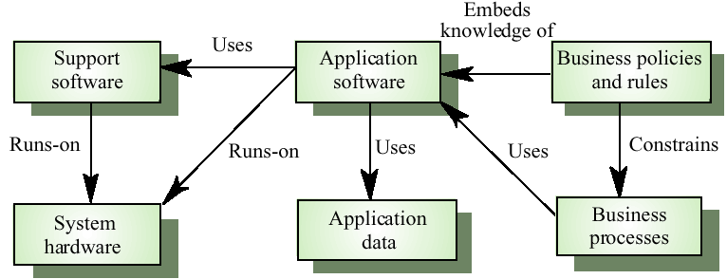
Legacy system components

Slide 10
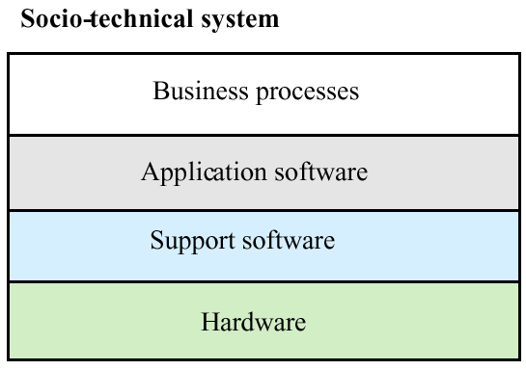
Layered model

Slide 11
System change
In principle, it should be possible to replace a layer in the system leaving the other layers unchanged
In practice, this is usually impossible
  Changing one layer introduces new facilities and higher level layers must then change to make use of these
  Changing the software may slow it down so hardware changes are then required
  It is often impossible to maintain hardware interfaces because of the wide gap between mainframes and client-server systems

Slide 12
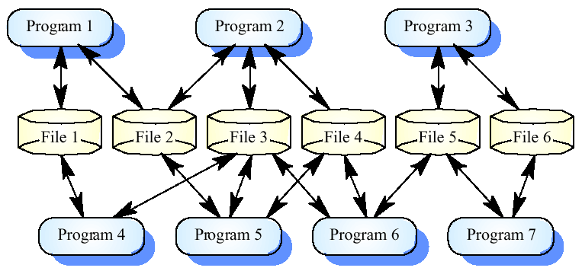
Legacy application system

Slide 13
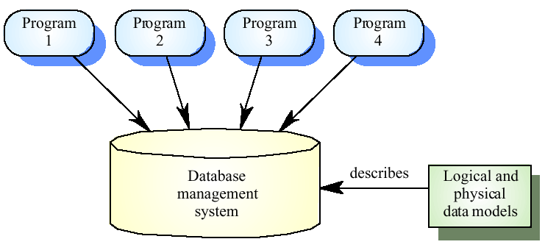
Database-centred system

Slide 14
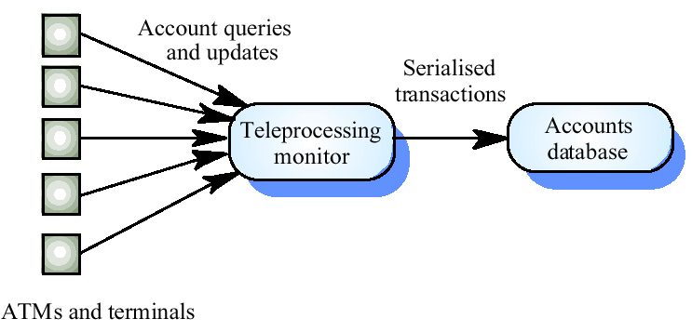
Transaction processing

Slide 15
Legacy data
The system may be file-based with incompatible files. The change required may be to move to a database-management system
In legacy systems that use a DBMS the database management system may be obsolete and incompatible with other DBMSs used by the business
The teleprocessing monitor may be designed for a particular DB and mainframe. Changing to a new DB may require a new TP monitor

Slide 16
Legacy system design
Most legacy systems were designed before object-oriented development was used
Rather than being organised as a set of interacting objects, these systems have been designed using a function-oriented design strategy
Several methods and CASE tools are available to support function-oriented design and the approach is still used for many business applications

Slide 17
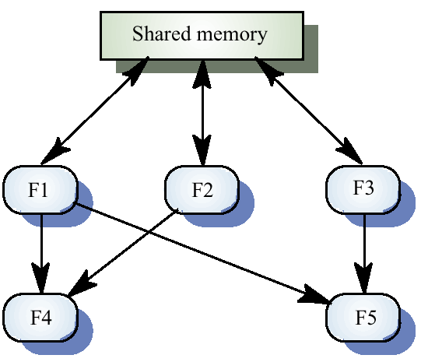
A function-oriented view of design

Slide 18
Functional design process
Data-flow design
  Model the data processing in the system using data-flow diagrams
Structural decomposition
  Model how functions are decomposed to sub-functions using graphical structure charts
Detailed design
  The entities in the design and their interfaces are described in detail. These may be recorded in a data dictionary and the design expressed using a PDL

Slide 19
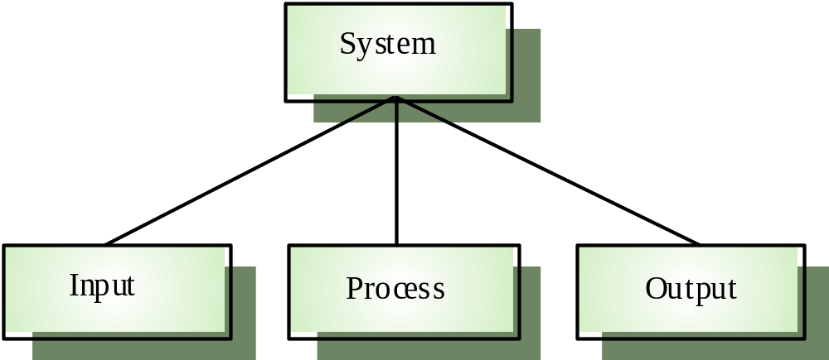
Input-process-output model

Slide 20
Input-process-output
Input components read and validate data from a terminal or file
Processing components carry out some transformations on that data
Output components format and print the results of the computation
Input, process and output can all be represented as functions with data ‘flowing’ between them

Slide 21
Functional design process
Data-flow design
  Model the data processing in the system using data-flow diagrams
Structural decomposition
  Model how functions are decomposed to sub-functions using graphical structure charts that reflect the input/process/output structure
Detailed design
  The functions in the design and their interfaces are described in detail.

Slide 22
Data flow diagrams
Show how an input data item is functionally transformed by a system into an output data item
Are an integral part of many design methods and are supported by many CASE systems
May be translated into either a sequential or parallel design. In a sequential design, processing elements are functions or procedures; in a parallel design, processing elements are tasks or processes

Slide 23
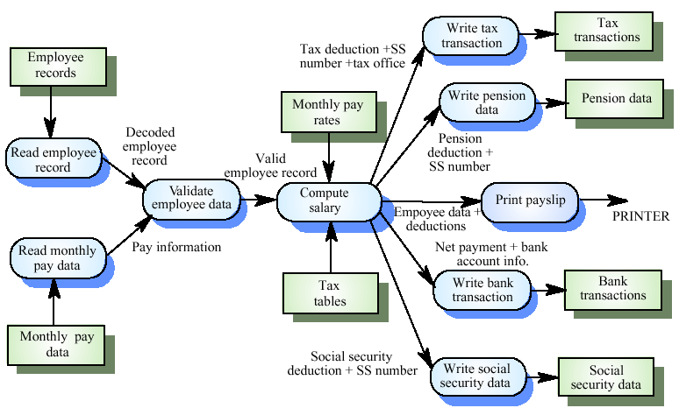
Payroll system DFD

Slide 24
Payroll batch processing
The functions on the left of the DFD are input functions
  Read employee record, Read monthly pay data, Validate employee data
The central function - Compute salary - carries out the processing
The functions to the right are output functions
  Write tax transaction, Write pension data, Print payslip, Write bank transaction, Write social security data

Slide 25
Transaction processing
A bank ATM system is an example of a transaction processing system
Transactions are stateless in that they do not rely on the result of previous transactions. Therefore, a functional approach is a natural way to implement transaction processing

Slide 26
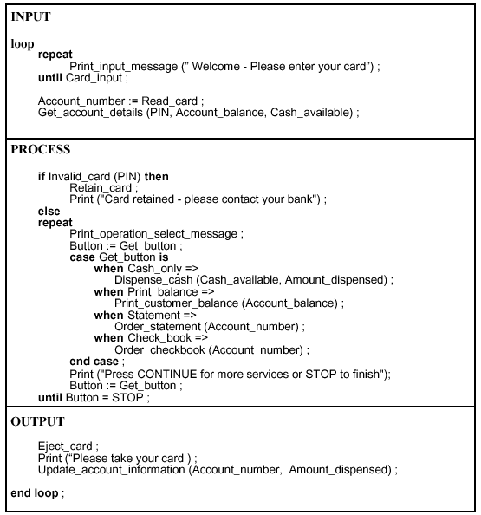
Design description of an ATM

Slide 27
Using function-oriented design
For some classes of system, such as some transaction processing systems, a function-oriented approach may be a better approach to design than an object-oriented approach
Companies may have invested in CASE tools and methods for function-oriented design and may not wish to incur the costs and risks of moving to an object-oriented approach

Slide 28
Legacy system assessment
Organisations that rely on legacy systems must choose a strategy for evolving these systems
  Scrap the system completely and modify business processes so that it is no longer required
  Continue maintaining the system
  Transform the system by re-engineering to improve its maintainability
  Replace the system with a new system
The strategy chosen should depend on the system quality and its business value

Slide 29
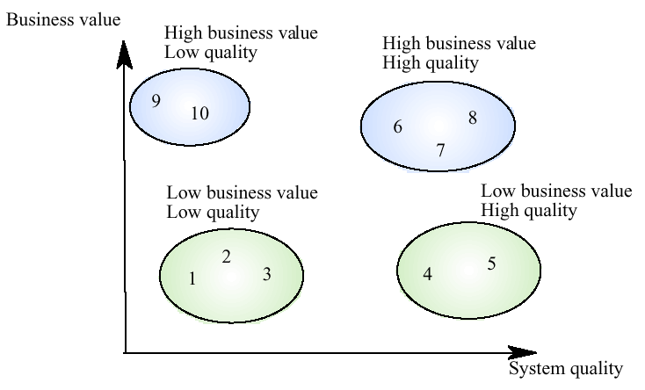
System quality and business value

Slide 30
Legacy system categories
Low quality, low business value
  These systems should be scrapped
Low-quality, high-business value
  These make an important business contribution but are expensive to maintain. Should be re-engineered or replaced if a suitable system is available
High-quality, low-business value
  Replace with COTS, scrap completely or maintain
High-quality, high business value
  Continue in operation using normal system maintenance

Slide 31
Business value assessment
Assessment should take different viewpoints into account
  System end-users
  Business customers
  Line managers
  IT managers
  Senior managers
Interview different stakeholders and collate results

Slide 32
System quality assessment
Business process assessment
  How well does the business process support the current goals of the business?
Environment assessment
  How effective is the system’s environment and how expensive is it to maintain
Application assessment
  What is the quality of the application software system

Slide 33
Business process assessment
Use a viewpoint-oriented approach and seek answers from system stakeholders
  Is there a defined process model and is it followed?
  Do different parts of the organisation use different processes for the same function?
  How has the process been adapted?
  What are the relationships with other business processes and are these necessary?
  Is the process effectively supported by the legacy application software?

Slide 34
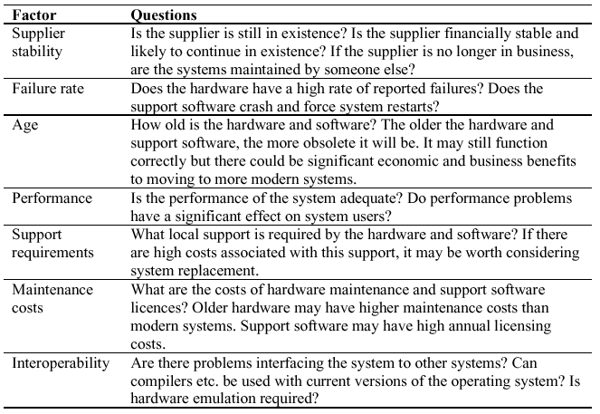
Environment assessment

Slide 35
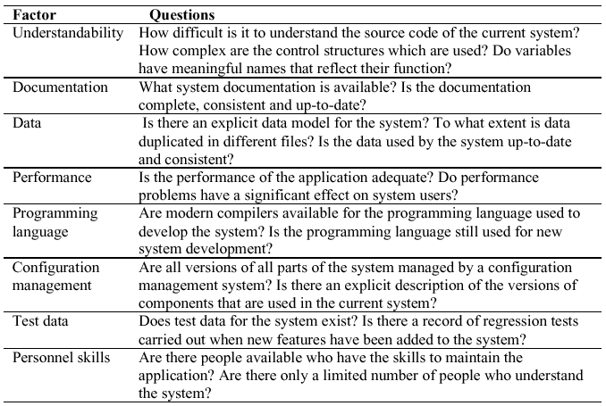
Application assessment

Slide 36
System measurement
You may collect quantitative data to make an assessment of the quality of the application system
  The number of system change requests
  The number of different user interfaces used by the system
  The volume of data used by the system

